Slide 1

CMSC 137
Data Communications and Networking
Lecture Module
08 – Analog Transmission

Slide 2
Module 8: Analog Transmission
Rozano S. Maniaol
Lecturer

Slide 3
Introduction
If digital transmission is desirable, why do we need analog transmission?
  If available channel bandwidth is scarce, hence we are forced to use a bandpass channel
Traditionally,
  Converting digital data to a bandpass analog signal is called digital to analog conversion
  Converting a low-pass analog signal to a bandpass analog signal is called analog to analog conversion

Slide 4
Digital to Analog Converion

Slide 5
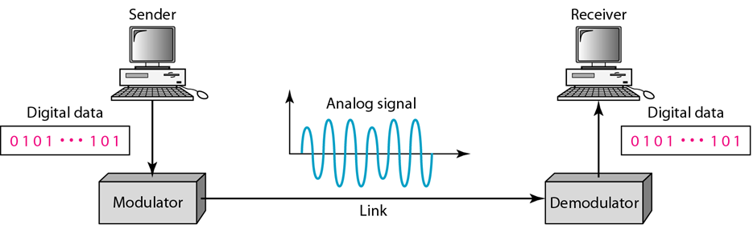
Digital to Analog Conversion
Changing the characteristics of an analog signal based on the information in digital data

Slide 6
Definitions
Bit rate is the number of bits per second. Baud rate is the number of signal elements per second. In analog transmission of digital data, the baud rate is less than or equal to the bit rate
Carrier signal (or carrier frequency) f_{c}
  High-frequency signal that acts as a base for the information signal that is produced by the sending device in analog transmission
Modulation (or shift keying) – modifying the characteristics of a carrier frequency to send data

Slide 7
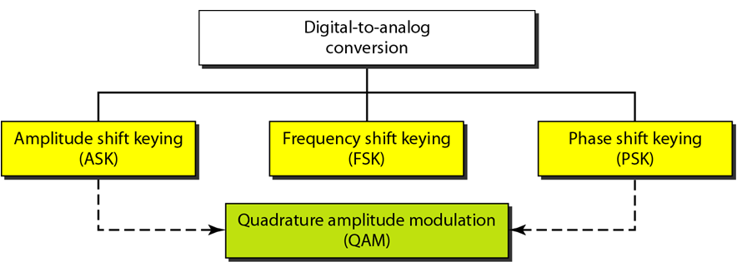
Types of Digital to Analog Conversion

Slide 8
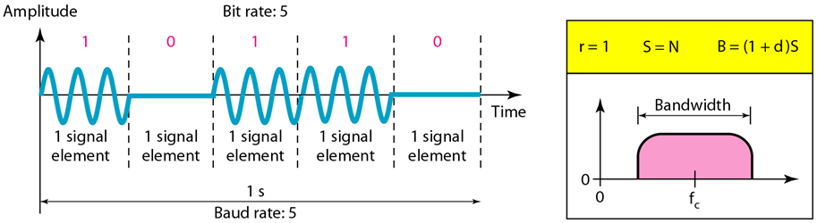
Amplitude Shift Keying (ASK)
Amplitude of the carrier signal is varied to create signal elements
Both frequency and phase remain constant while amplitude changes

Slide 9
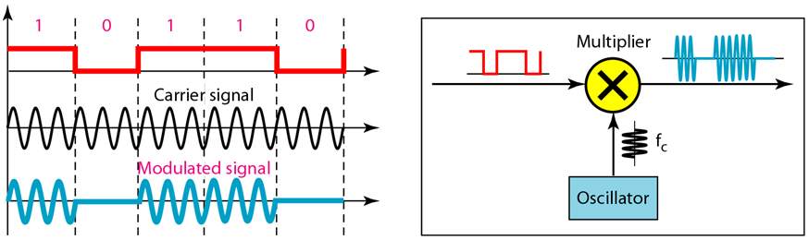
Implementation of BASK

Slide 10
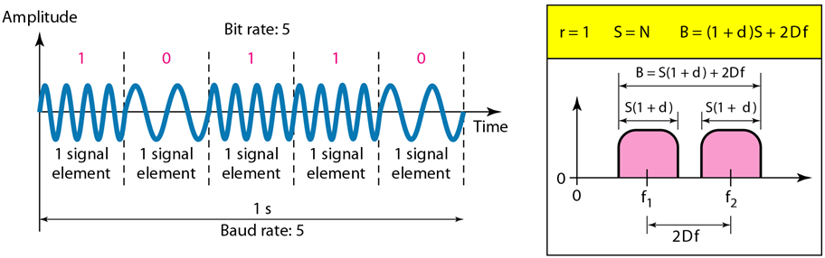
Frequency Shift Keying (FSK)
Frequency of the carrier signal is varied to represent data
Both peak amplitude and phase remain constant for all signal elements

Slide 11
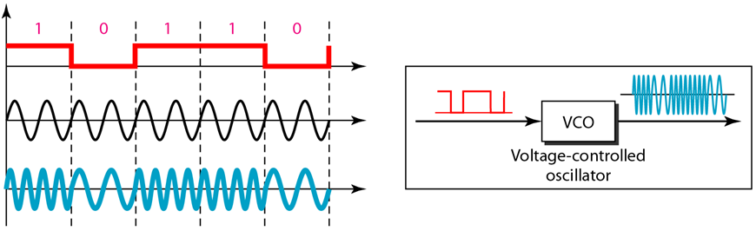
Implementation of BFSK

Slide 12
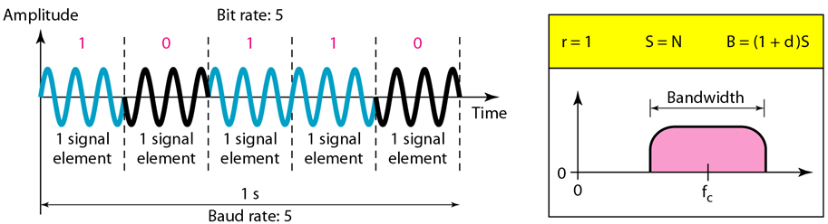
Phase Shift Keying (PSK)
The phase of the carrier is varied to represent two or more different signal elements
Both peak amplitude and frequency remain constant

Slide 13
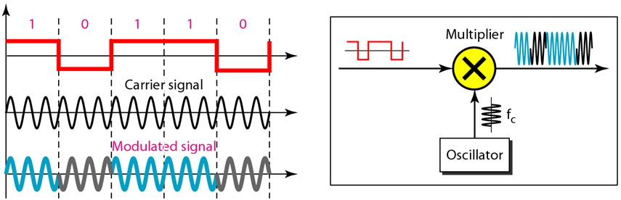
Implementation of BPSK

Slide 14
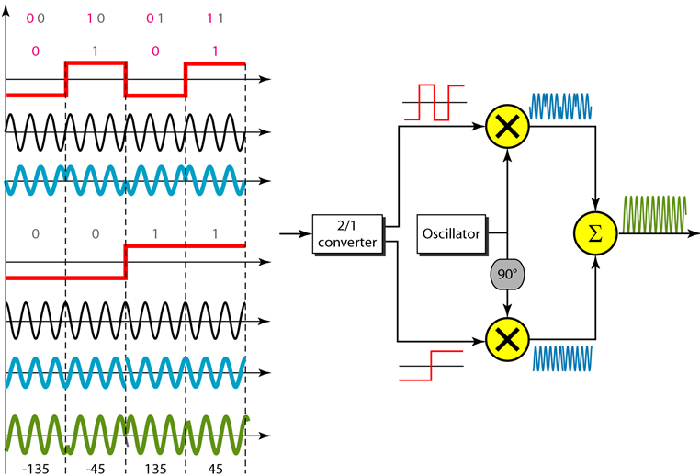
Implementation of QPSK

Slide 15
Constellation Diagram
Helps to define the amplitude and phase of a signal element when we are using two carriers, one in quadrature of the other
Useful for dealing with multilevel ASK, PSK or QAM
The x-axis represents the in-phase carrier and the y-axis represents the quadrature carrier
A signal element is represented by a dot
The bit or combination of bits it can carry is often written next to it

Slide 16
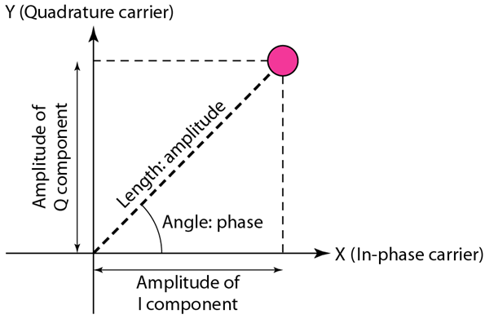
Constellation Diagram

Slide 17
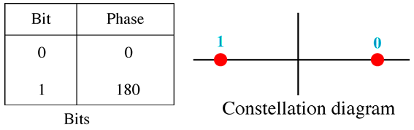
PSK Constellation Diagram

Slide 18
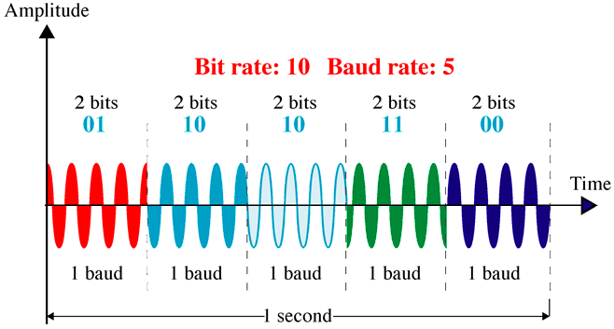
4-PSK

Slide 19
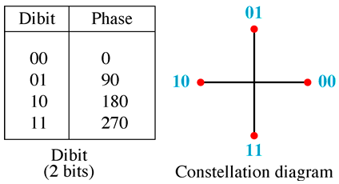
4-PSK Constellation Diagram

Slide 20
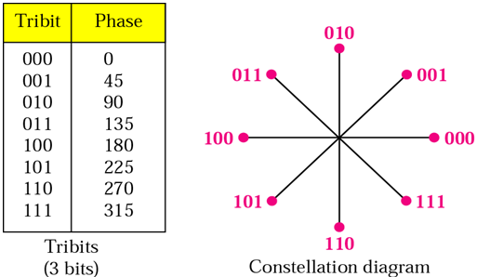
8-PSK Constellation Diagram

Slide 21
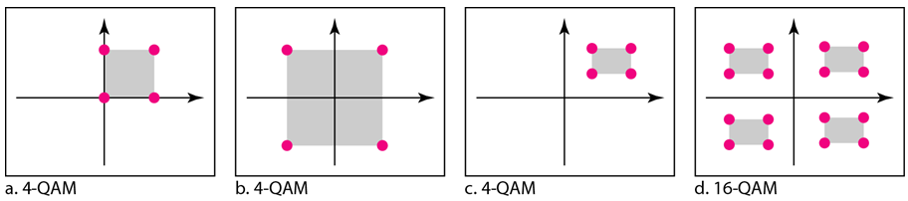
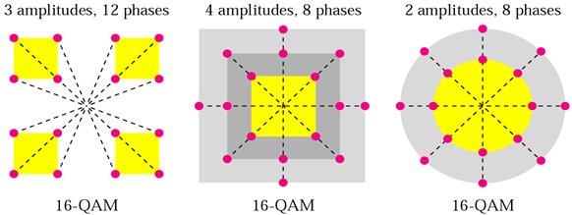
Quadrature Amplitude Modulation (QAM)
Combination of ASK and PSK

Slide 22
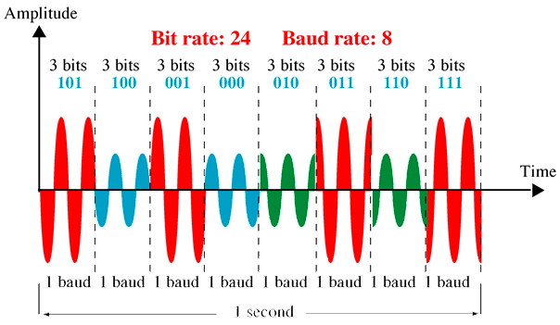
8-QAM Signal

Slide 23
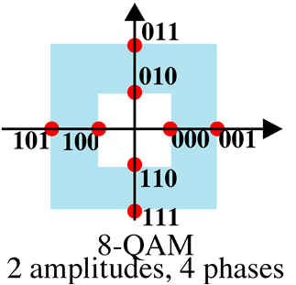
8-QAM Constellation Diagram

Slide 24
Analog to Analog Conversion

Slide 25
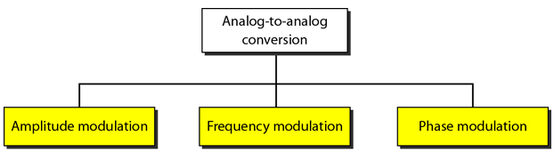
Analog to Analog Conversion
Representation of analog information by an analog signal
Modulation is needed if medium is bandpass in nature or if only a bandpass channel is available

Slide 26
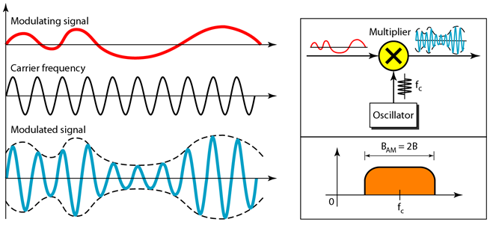
Amplitude Modulation (AM)
Carrier signal is modulated so that its amplitude varies with the changing amplitudes of the modulating signal
The modulating signal is the envelope of the carrier

Slide 27
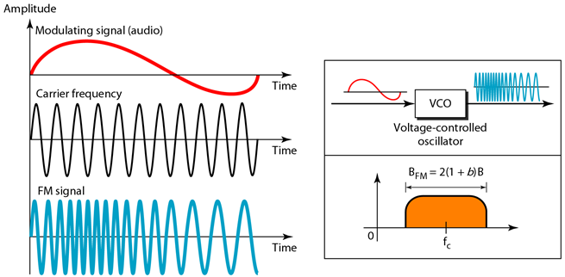
Frequency Modulation (FM)
Frequency of the carrier signal is modulated to follow the changing voltage level (amplitude) of the modulating signal

Slide 28
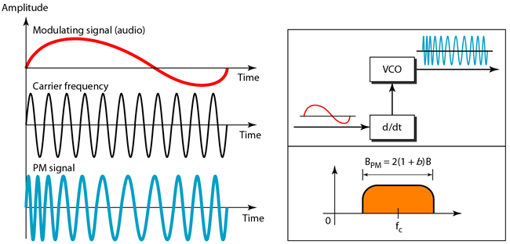
Phase Modulation (PM)
Phase of the carrier signal is modulated to follow the changing voltage level of the modulating signal
As the amplitude increases, the magnitude of the phase lead increases
As the amplitude decreases, the magnitude of the phase lag increases

Slide 29
FM vs PM
In FM, the instantaneous change in the carrier frequency is proportional to the amplitude of the modulating signal.
In PM, the instantaneous change in the carrier frequency is proportional to the derivative of the amplitude of the modulating signal.
PM is used in mobile communication systems, while FM is used mainly in FM broadcasting

Slide 30
References
Forouzan, B.A. 2013. Data Communications and Networking, 5th Ed. McGraw-Hill, New York.

